Slide 1
Speech Emotion Recognition
David Gigu Cheeran
MSc Data Science
University of Essex
Reg No: 2101139

Slide 2
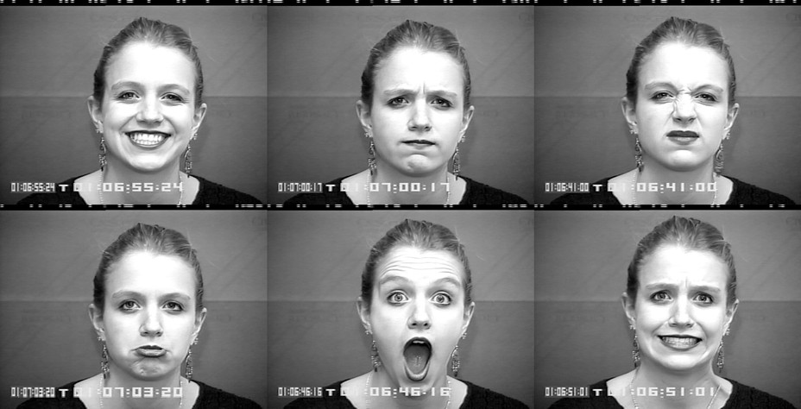
Aim:
To create and train a model that can recognise human emotion when given a voice sample.

Slide 3
Dataset:
There are many datasets available for speech emotion recognition. Since we have to make sure that we have to deal with the same set of emotions throughout the project we can concentrate on a single dataset.
RAVDESS Emotional Speech Audio
Stands for Ryerson Audio-Visual Database of Emotional Speech and Song.

Slide 4
RAVDESS database
Audio only files(16bit, 48kHz, .wav)
24.8GB(1440 files)
3 second audio clips
Spoken by 24 different actors(12 male and 12 female)
2 sentences in 8 different emotions

Slide 5
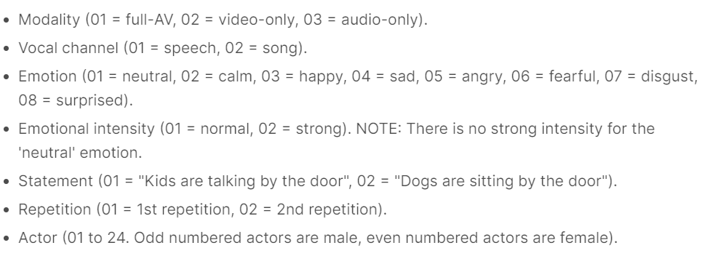
Filename Identifiers

Slide 6
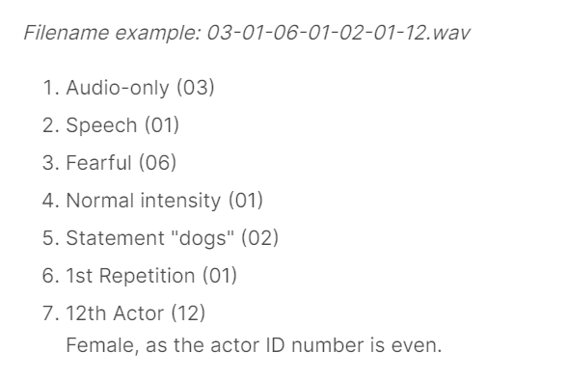

Slide 7
Feature Extraction:
Feature extraction was done using 3 methods:
MFCC(Mel Frequency Cepstral Coefficient)
Chromagram
Mel spectrogram

Slide 8
Modelling:
Five models were used for training and testing:
Random Forest Classifier
Multi Layer Perceptron
K Nearest Neighbor Classifier
Gaussian Process Classifier
XGBoost Classifier

Slide 9
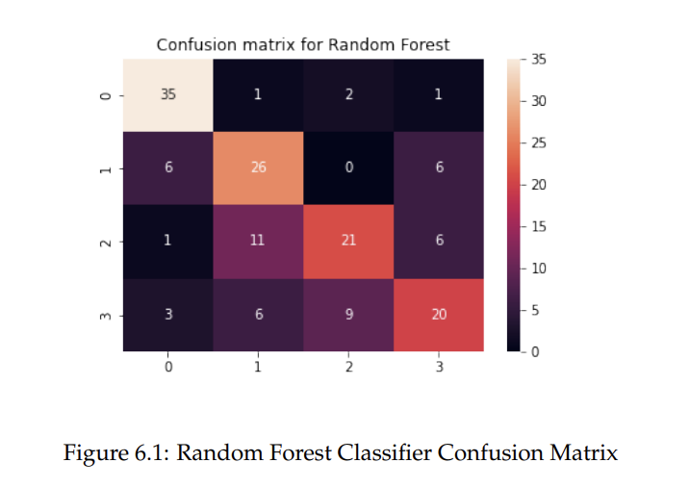
Evaluating the model:
Since the problem at hand is classification, we have metrics like accuracy, recall, precision, f1 score.
Since there are multiple classes(emotions), the confusion matrix would look something like the one below.

Slide 10
Since the accuracy of the models were not that good when classifying 8 emotions, 4 emotions were considered. The results of the models were compared again.
Data Augmentation was also done to check if the result improves.

Slide 11
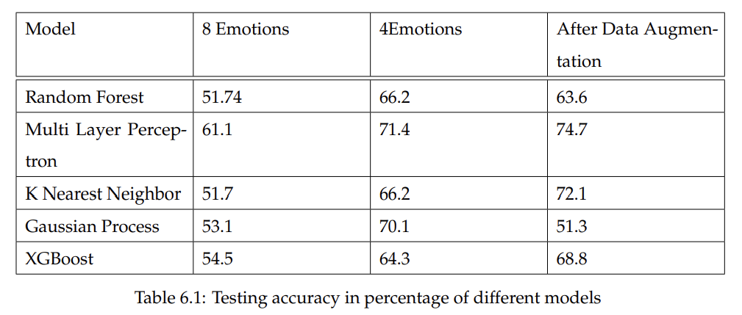
Accuracy of different models:

Slide 12
Analysis of Results
Multi Layer Perceptron was best in all cases.
Worst performance was from Random Forest and K Nearest Neighbor when classifying 8 emotions.
For 4 emotions the worst performance was from XGBoost.
After Data Augmentation, worst performance was from Gaussian Process classifier.
All models improved when classifying 4 emotions instead of 8.
After data augmentation, the performance of MLP, KNN and XGBoost improved while that of Random Forest and Gaussian Process became worse.

Slide 13
Thank You

